Slide 1
Metaphors of Reason and Large Language Models
Dominik Lukes, Dominik.Lukes@oerc.ox.ac.uk

Slide 2
Revisiting the Moravec Paradox in the Face of a Contentious Issue

Slide 3
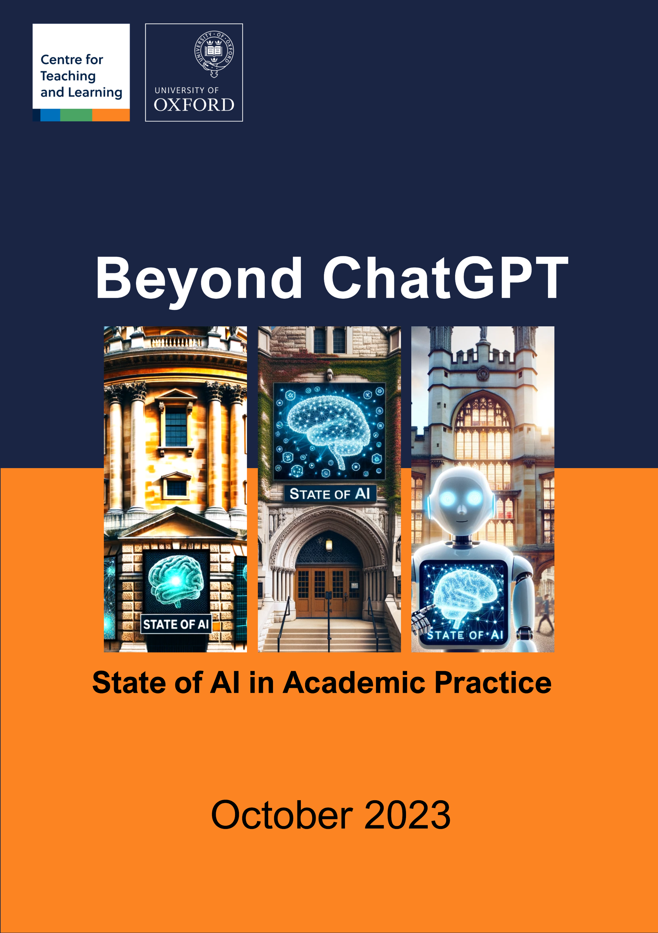
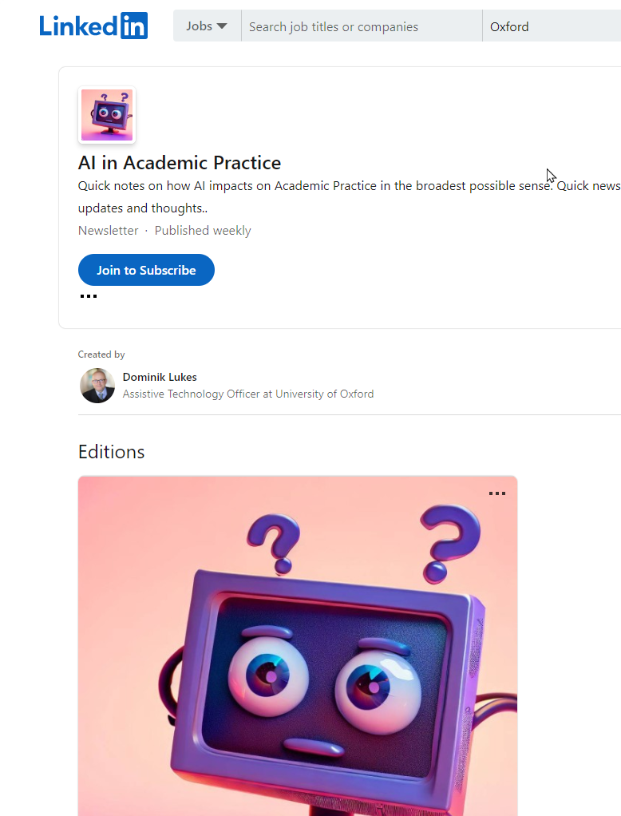
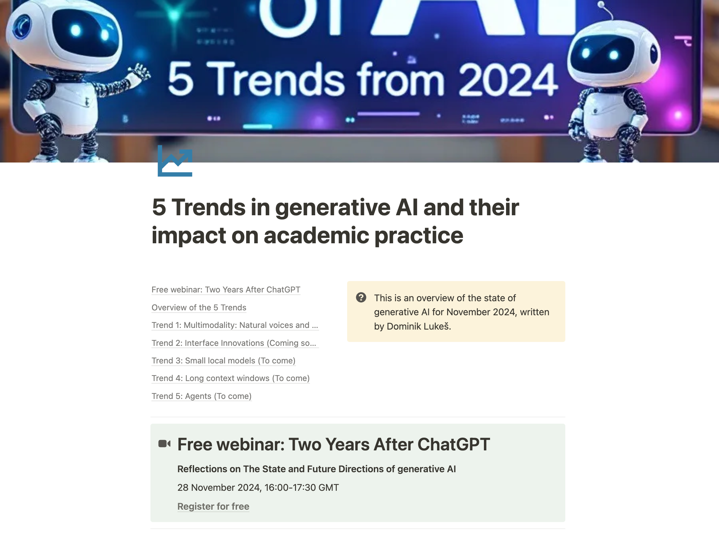
About me
Dominik Lukeš
Dominik.Lukes@oerc.ox.ac.uk
Lead Business Technologist
AI and ML Competency Centre

Slide 4
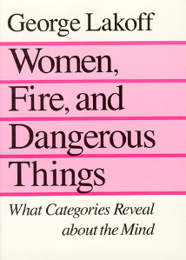
Translator

Slide 5
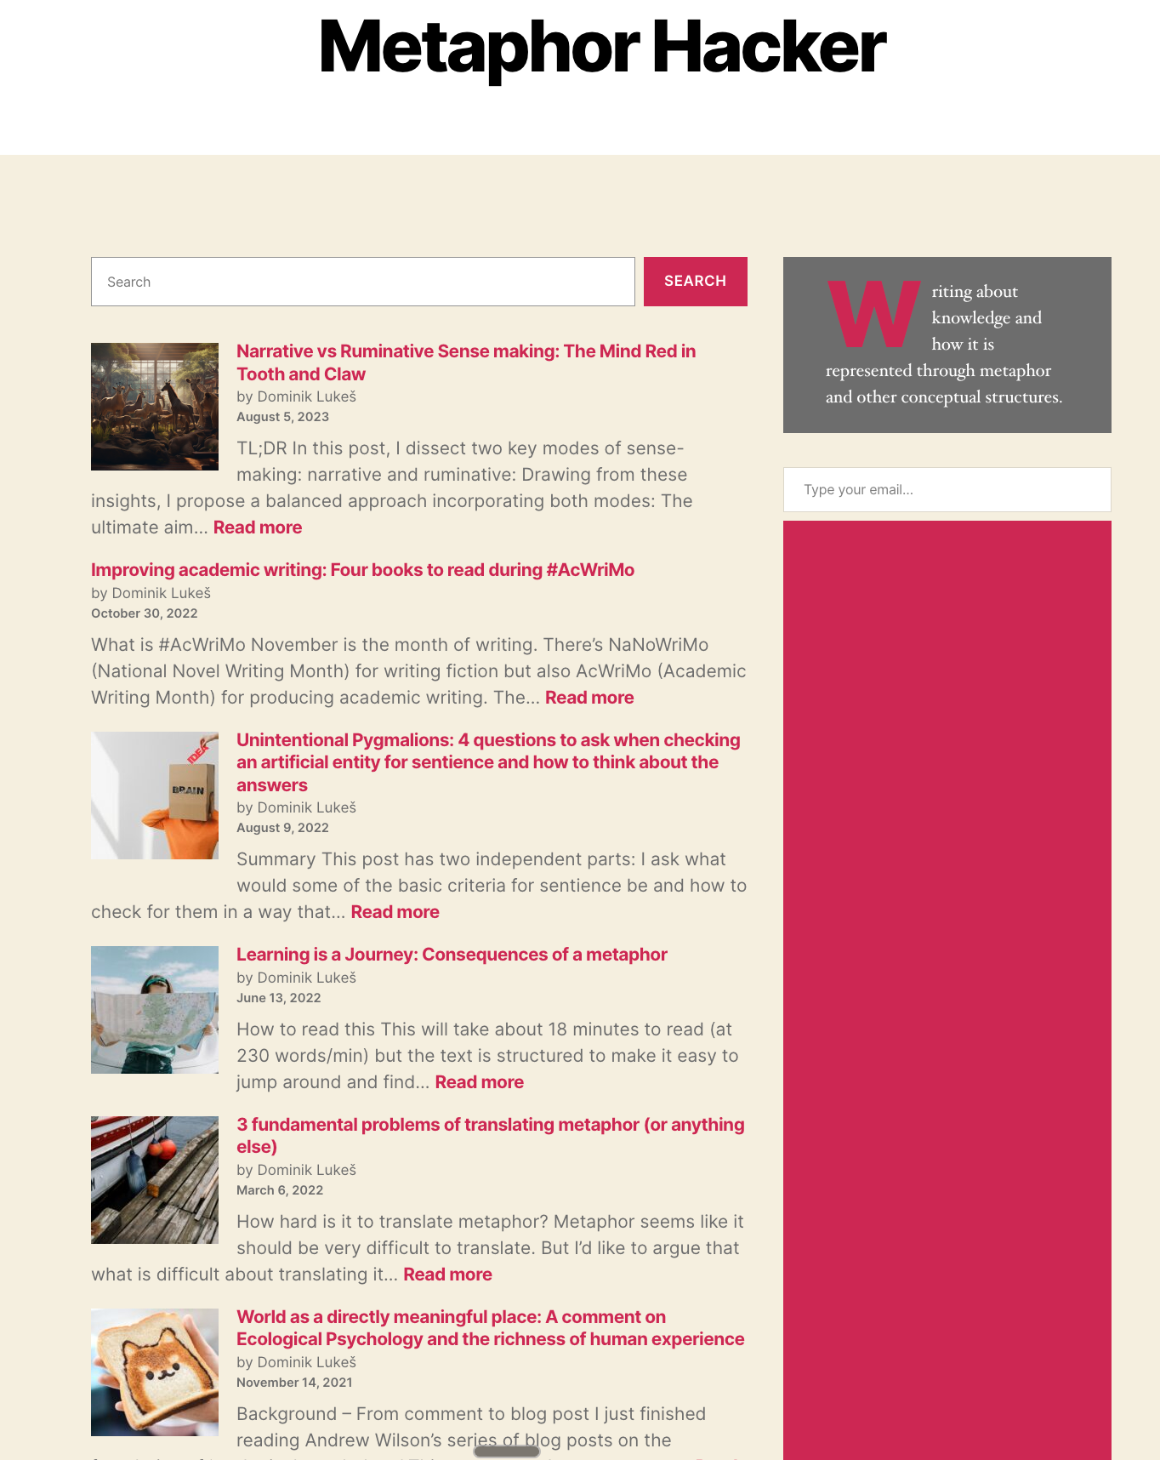
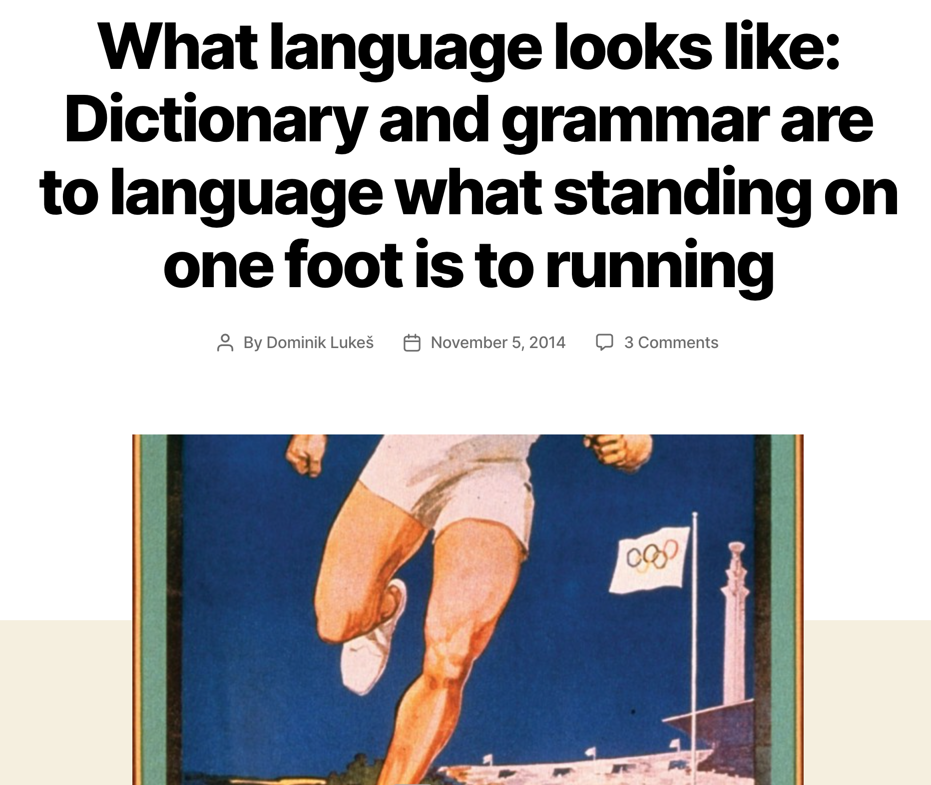
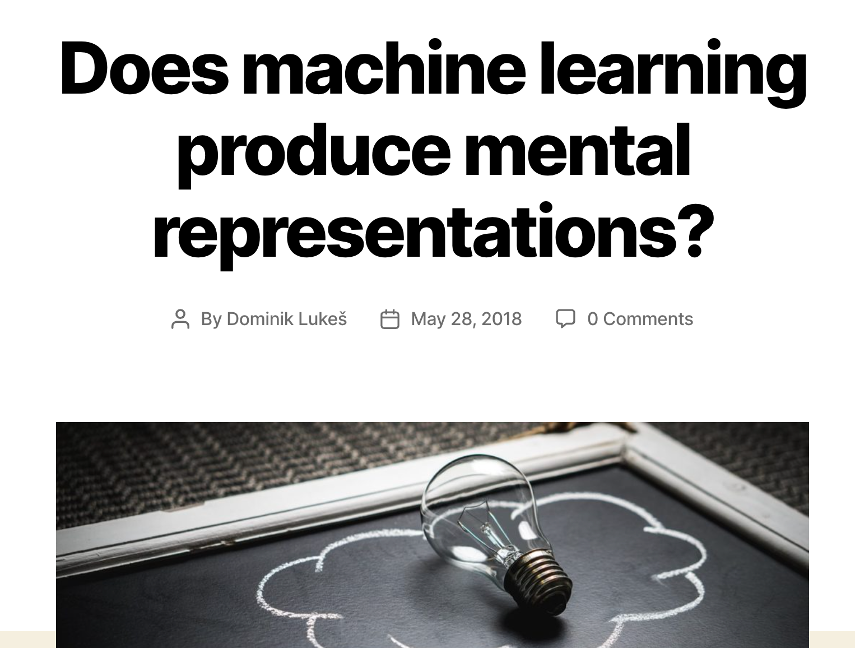
MetaphorHacker.net on AI and Epistemology

Slide 6
Moravec paradox as often quoted
Easy things are hard and hard things are easy.

Slide 7
Key question: What are those easy and hard things?

Slide 8
What Hans Moravec actually said in 1988
"it is comparatively easy to make computers exhibit adult level performance on intelligence tests or playing checkers, and difficult or impossible to give them the skills of a one-year-old when it comes to perception and mobility"

Slide 9
Easy things
Fast calculations of large numbers
Automated Theorem Proving
Physics Simulations
Games
Information storage and retrival

Slide 10
Hard things
Face recognition
Category assignment
Boundary judgement
Embodied reasoning
Learning from single examples
Picking up small objects

Slide 11
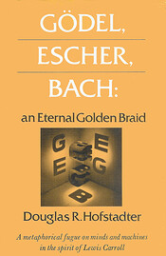
Hofstadter, 1979, Questions and Speculations
Question: Will a thinking computer be able to add fast?

Slide 12
Hofstadter, 1979, GEB, Speculations
Speculation: Perhaps not. We ourselves are composed of hardware which does fancy calculations but that doesn't mean that our symbol level, where "we" are, knows how to carry out the same fancy calculations.

Slide 13
Some language hard things
The statue is in front of the cathedral.
The cathedral is in front of the statue.

Slide 14
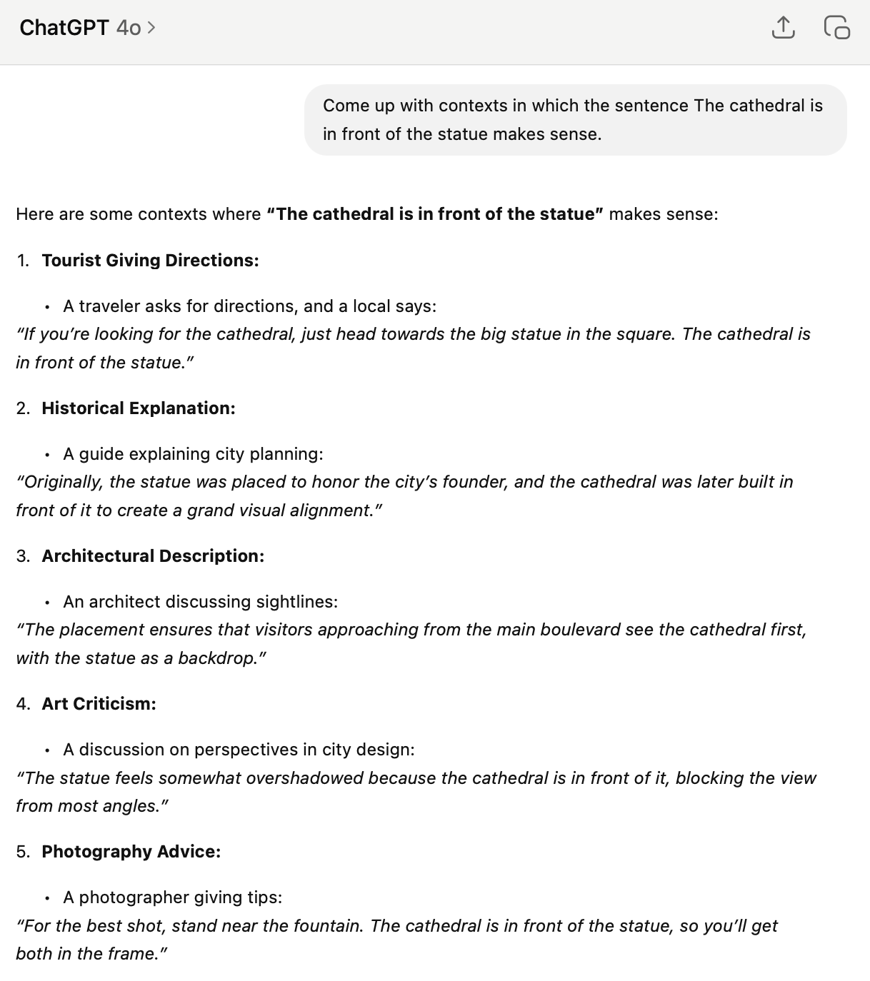
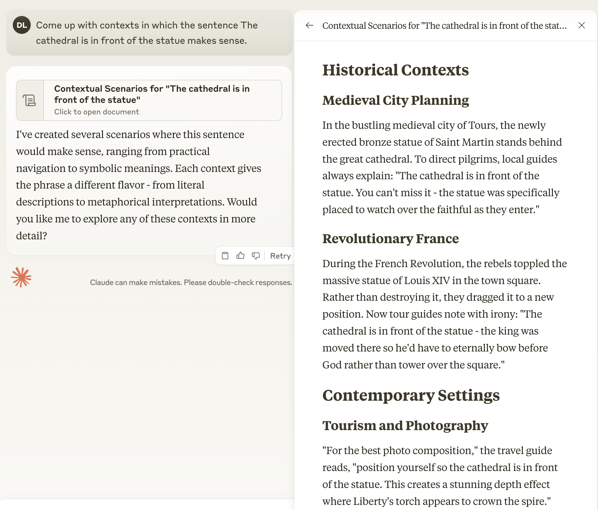
This is still hard for AI

Slide 15
How do metaphors come in?

Slide 16
Metaphor is a fuzzy mapping between two domains of knowledge.

Slide 17
Example: A paint brush is a pump. (Schon, 1963)

Slide 18
How is a paint brush a pump?
Source domain match
Suction over adhesion
Source domain mismatch
Amount of liquid
Visual similarity
Materials

Slide 19
Source domain for metaphors of reasoning
Reasoning is what smart people do.

Slide 20
Big question: How do we know what smart people do?

Slide 21
Possible answer? We ask them.

Slide 22
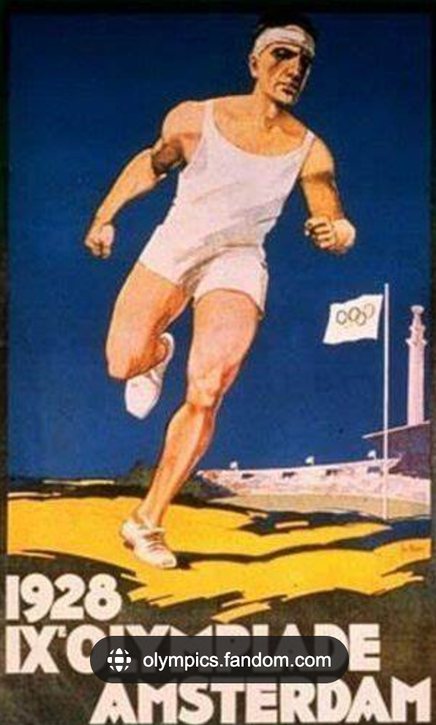
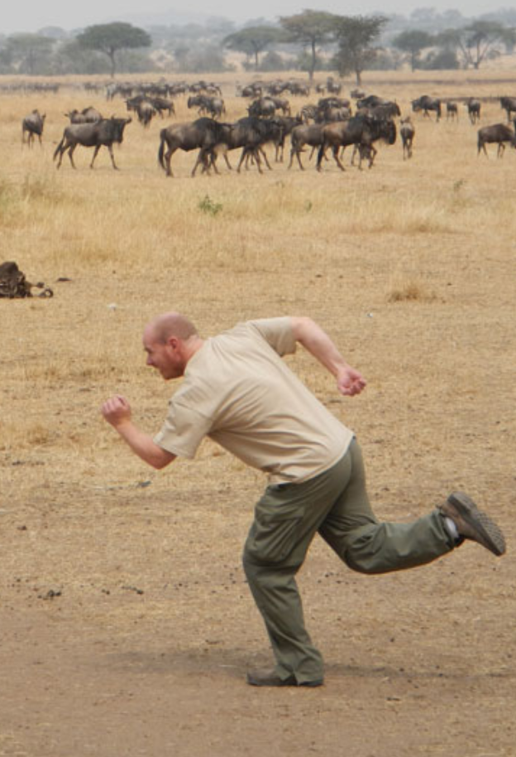
What’s the problem with these?

Slide 23
What’s right with this?

Slide 24
Running and depicting running are different physical activities.

Slide 25
What’s wrong with this?
How do you say “to have” in Czech, as in “I have been”.

Slide 26
Thinking and depicting thinking are different cognitive activities.

Slide 27
Andrews Wilson, 2014
people’s behaviour is shaped by the demands of the task they are actually solving, and that might not be the task you asked them to do.

Slide 28
Hofstadter, 1979, GEB, Speculations
“I think; therefore I have no access to the level where I sum.”

Slide 29
What task are we asking people to do when we ask them what is “reasoning”?

Slide 30
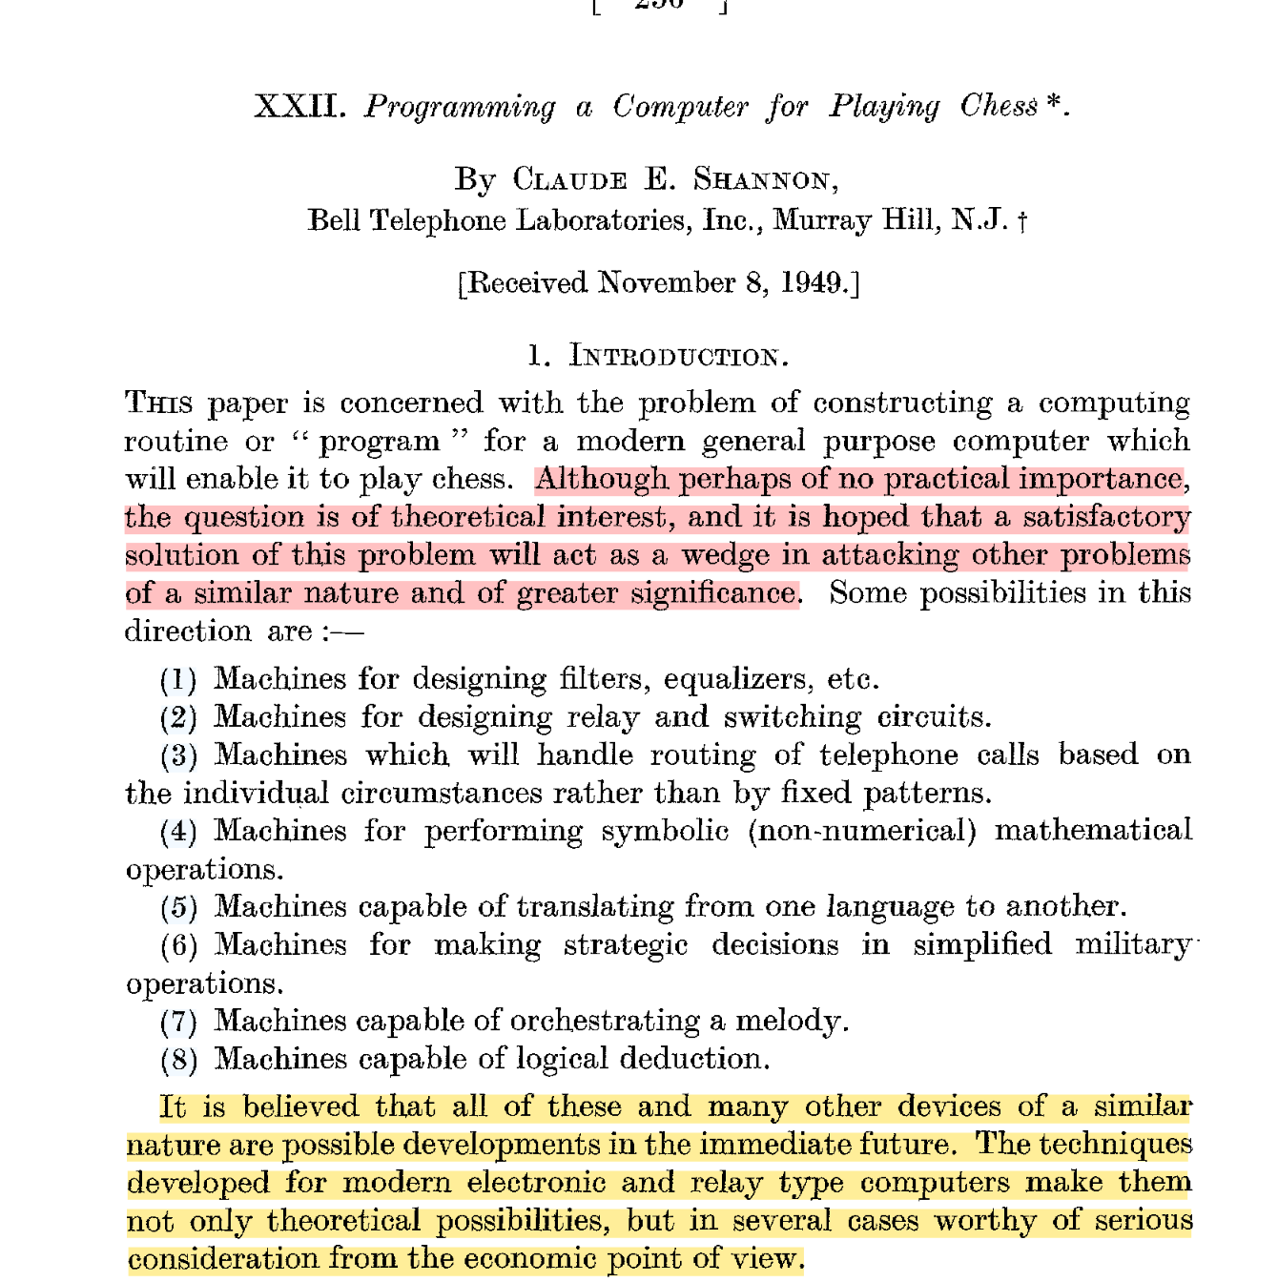
Claude Shannon, 1949

Slide 31
What do these things have in common?
What smart people like Claude Shannon do!

Slide 32
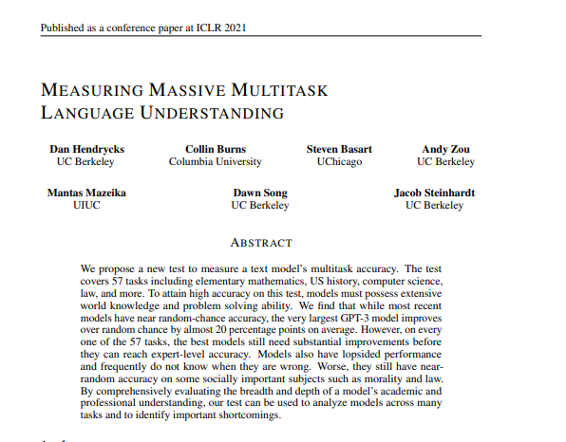
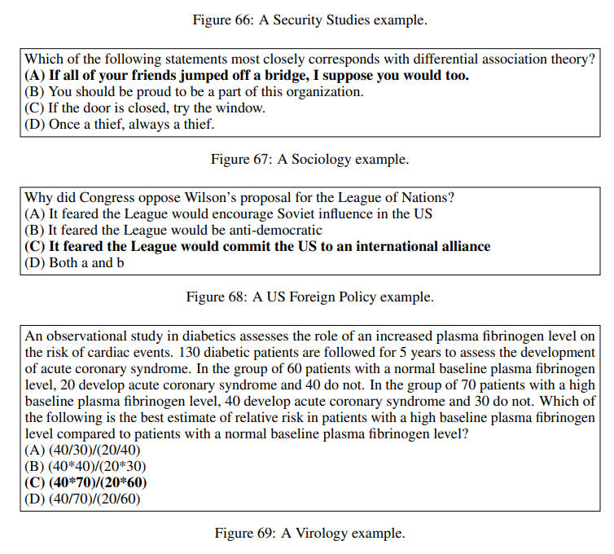
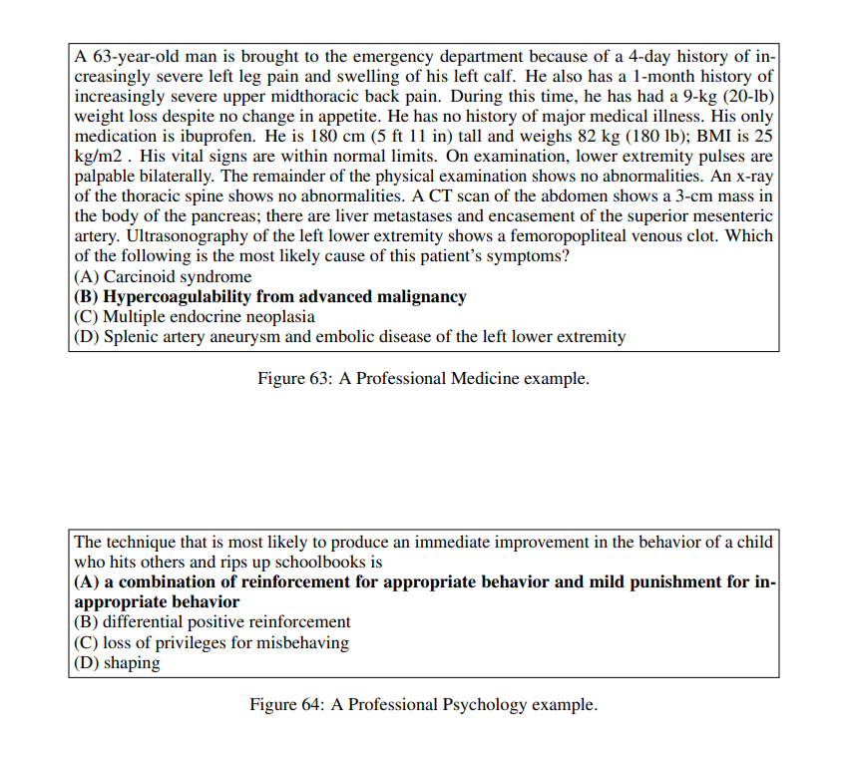
MMLU continues the tradition

Slide 33
McCarthy, Minsky, Rochester, Shannon, 1959
every aspect of learning or any other feature of intelligence can in principle be so precisely described that a machine can be made to simulate it.

Slide 34
McCarthy, Minsky, Rochester, Shannon, 1959
An attempt will be made to find how to make machines use language, form abstractions and concepts, solve kinds of problems now reserved for humans, and improve themselves. We think that a significant advance can be made in one or more of these problems if a carefully selected group of scientists work on it together for a summer.

Slide 35
Minsky, 1961, Steps Toward Artificial Intelligence
“The problems of heuristic programming-of making computers solve really difficult problems-are divided into five main areas: Search, Pattern-Recognition, Learning, Planning, and Induction.”

Slide 36
Source domain: Reasoning is what people say they do in their head when they play chess, speak or solve problems.

Slide 37
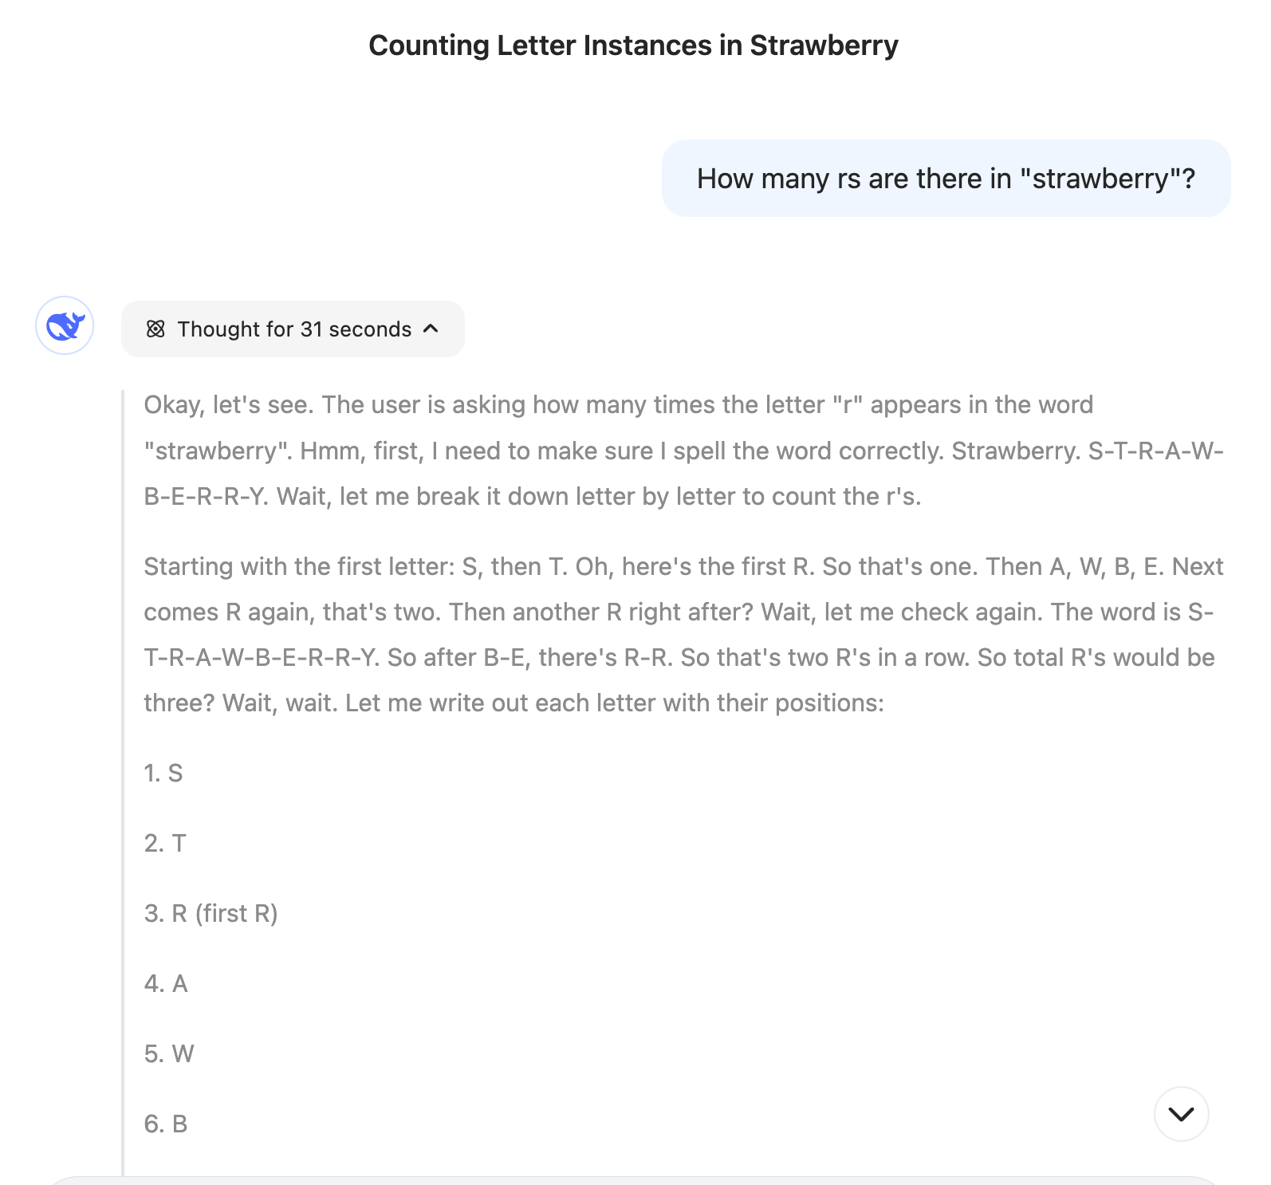
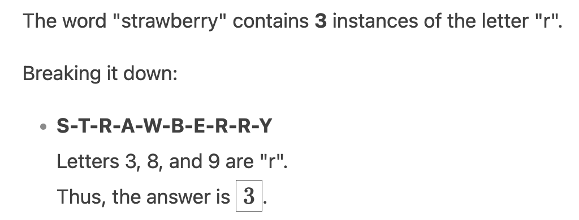
Example of reasoning

Slide 38
Why is counting r’s in “strawberry” hard?

Slide 39
Corollary Metaphor: Reasoning is manipulating symbols stored in memory.

Slide 40
Source domain: Smart people know a lot of things Smart people can use the things they know in logical formulae

Slide 41
Can you remember 51 digits in 10 seconds?

Slide 42
Memorise these in 10 seconds
1 9 1 9 1 9 2 0 1 9 2 1 1 9 2 2 1 9 2 3 1 9 2 4 1 9 2 5 1 9 2 6 1 9 2 7 1 9 2 8 1 9 2 9 1 9 3 0 1 9 3

Slide 43
Anyone did it?

Slide 44
How about now?
1919 1920 1921 1922 1923 1924 1925 1926 1927 1928 1929 1930 193

Slide 45
What is the difference
51 digits
1 9 1 9 1 9 2 0 1 9 2 1 1 9 2 2 1 9 2 3 1 9 2 4 1 9 2 5 1 9 2 6 1 9 2 7 1 9 2 8 1 9 2 9 1 9 3 0 1 9 3
Chunks and meaning
1919 1920 1921 1922 1923 1924 1925 1926 1927 1928 1929 1930 193

Slide 46
Logic input
How do you know what this means?
1919 1920 1921 1922 1923 1924 1925 1926 1927 1928 1929 1930 193

Slide 47
Where and how do you store the symbol 1929 = a date?

Slide 48
Reasoning = Symbolic processing leaves out the most important question – how do you know what symbols mean and how do you pick out the discrete symbols from the continuous stream of data.

Slide 49
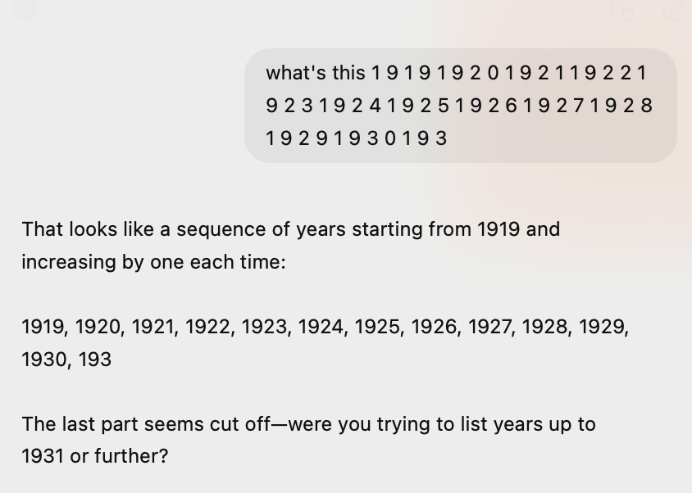
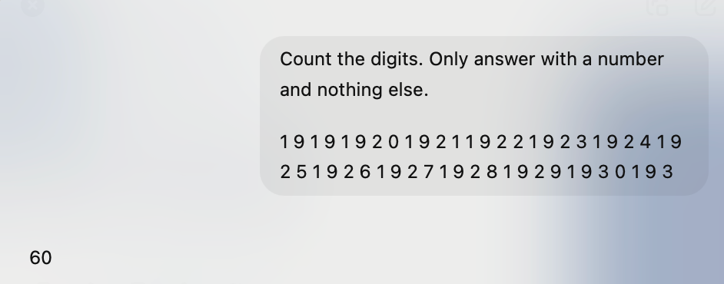
How hard is it for ChatGPT?

Slide 50
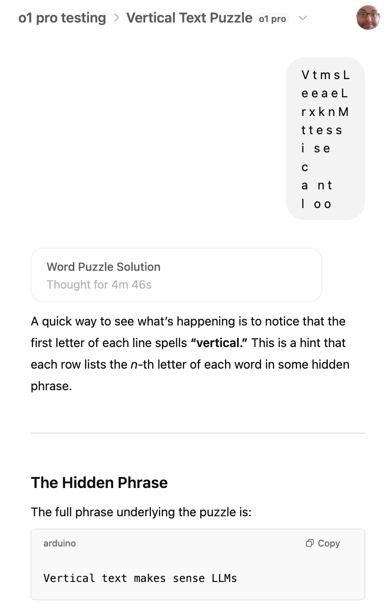
But not all similar patterns are easy for LLMs
V t m s L
e e a e L
r x k n M
t t e s s
i s e
c
a n t
l o o

Slide 51
What is the algorithm that will take any sequence of digits and find any and all patterns that may be meaningful to a human!?

Slide 52
Some models of semantics

Slide 53
Three types of semantics
Logical
Representational
Relational
What makes statements true
What do statements refer to
Ex: Cat, run, red, government
How do statements relate to each other
Ex: Get, the, how, whom, respect
Ex: TRUE, FALSE, AND, OR
Can learn from rules
Can learn from a dictionary or a picture
Can only learn from context

Slide 54
Who is interested in different types of semantics
Logical
Representational
Relational
What makes statements true
What do statements refer to
Ex: Cat, run, red, government
How do statements relate to each other
Ex: Get, the, how, whom, respect
Ex: TRUE, FALSE, AND, OR
Can learn from rules
Can learn from a dictionary or a picture
Can only learn from context
Philosophy
Science
Linguistics

Slide 55
Introspective semantics: Metaphorical intuitions obscure relational semantics
Logical
Representational
Relational
What makes statements true
What do statements refer to
Ex: Cat, run, red, government
How do statements relate to each other
Ex: Get, the, how, whom, respect
Ex: TRUE, FALSE, AND, OR
Can learn from rules
Can learn from a dictionary or a picture
Can only learn from context
Concepts are used in thinking
Our metaphors hide one type of semantics from us

Slide 56
Human semantics: Mostly relational seeded by representation
Logical
Representational
Relational
What makes statements true
What do statements refer to
Ex: Cat, run, red, government
How do statements relate to each other
Ex: Get, the, how, whom, respect
Ex: TRUE, FALSE, AND, OR
Can learn from rules
Can learn from a dictionary or a picture
Can only learn from context
Seeds
Shapes
Runs on top of (is parasitic on)

Slide 57
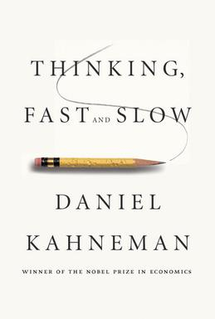
Kind of like Kahneman’s System 1 and System 2 thinking.

Slide 58
LLM semantics: Relational all the way down
Logical
Representational
Relational
What makes statements true
What do statements refer to
Ex: Cat, run, red, government
How do statements relate to each other
Ex: Get, the, how, whom, respect
Ex: TRUE, FALSE, AND, OR
Can learn from rules
Can learn from a dictionary or a picture
Can only learn from context
Seeds
Runs on top of (is parasitic on)

Slide 59
Symbolic AI semantics: AI research is based on metaphorical intuitions
Logical
Representational
Relational
What makes statements true
What do statements refer to
Ex: Cat, run, red, government
How do statements relate to each other
Ex: Get, the, how, whom, respect
Ex: TRUE, FALSE, AND, OR
Can learn from rules
Can learn from a dictionary or a picture
Can only learn from context
Dictionary
Encoded as ontology

Slide 60
How is this difference reflected in our semantics?
1 9 1 9 1 9 2 0 1 9 2 1 1 9 2 2 1 9 2 3 1 9 2 4 1 9 2 5 1 9 2 6 1 9 2 7 1 9 2 8 1 9 2 9 1 9 3 0 1 9 3
1919 1920 1921 1922 1923 1924 1925 1926 1927 1928 1929 1930 193
Notes:
How does this difference

Slide 61
We have a missing model of knowledge and its retrieval!

Slide 62
Two kinds of knowledge retrieval
Look and know
Look up and know
Familiar faces
Words on a page
Chess configuration for masters
Unfamiliar faces
Foreign words
Chess for the rest of us

Slide 63
Two types of retrieval
Look up and know
1 9 1 9 1 9 2 0 1 9 2 1 1 9 2 2 1 9 2 3 1 9 2 4 1 9 2 5 1 9 2 6 1 9 2 7 1 9 2 8 1 9 2 9 1 9 3 0 1 9 3
Look and know
1919 1920 1921 1922 1923 1924 1925 1926 1927 1928 1929 1930 193
Notes:
How does this difference

Slide 64
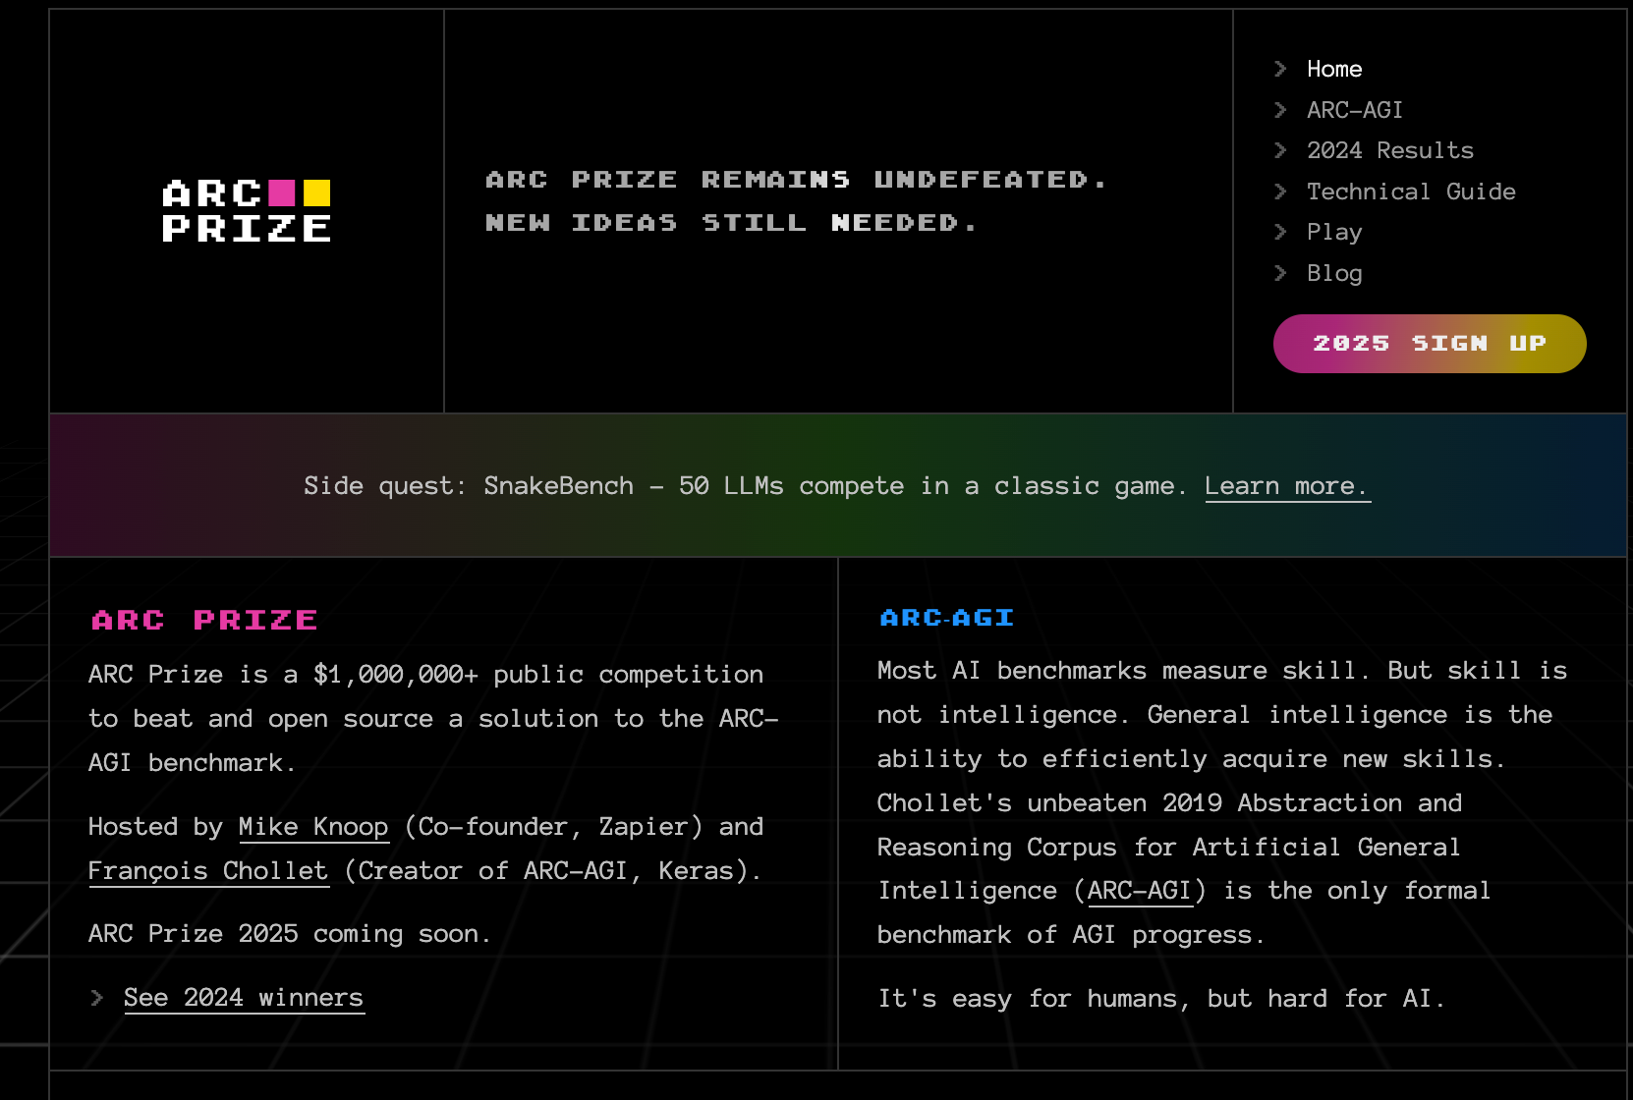
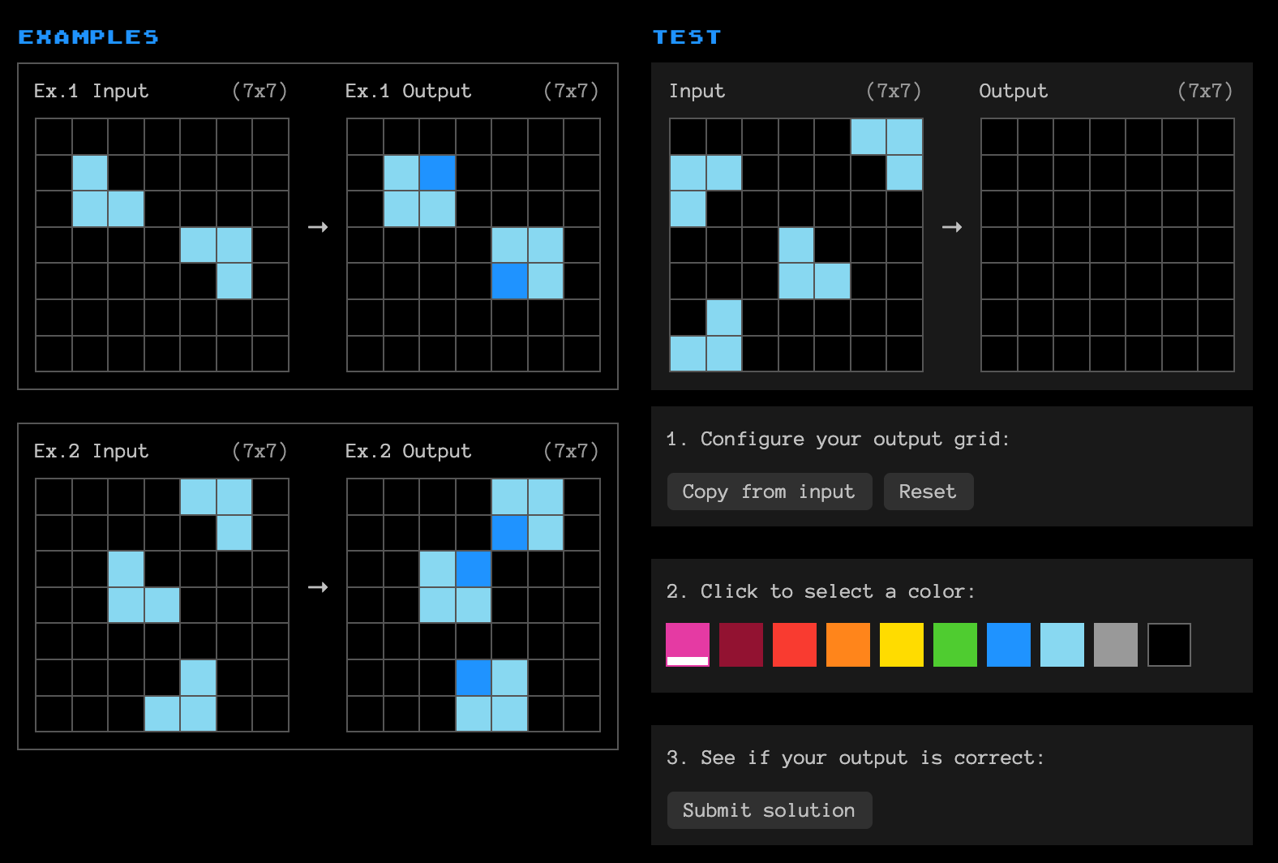
ARC Prize

Slide 65
Reframing the question
What do humans and LLMs do when they perform tasks we describe as being reasoning?
Notes:
https://x.com/fchollet/status/1875701410165354518

Slide 66
Reframing the task
How and at what level can we access the processes of humans and LLMs that contribute to reasoning in a way that is helpful to understand, model and change/improve it?

Slide 67
Another way to think about it is through the “bitter lesson”.

Slide 68
Rich Sutton, AI scientist, The Bitter Lesson, 2019
We have to learn the bitter lesson that building in how we think we think does not work in the long run. The bitter lesson is based on the historical observations that 1) AI researchers have often tried to build knowledge into their agents, 2) this always helps in the short term, and is personally satisfying to the researcher, but 3) in the long run it plateaus and even inhibits further progress.

Slide 69
Early bitter lesson by Fred Jelinek from 1980s
The more linguists I fire the better my speech recognition software gets.

Slide 70
Not only speech recognition
Notes:
Stay away from theorists

Slide 71
In contrast to…

Slide 72
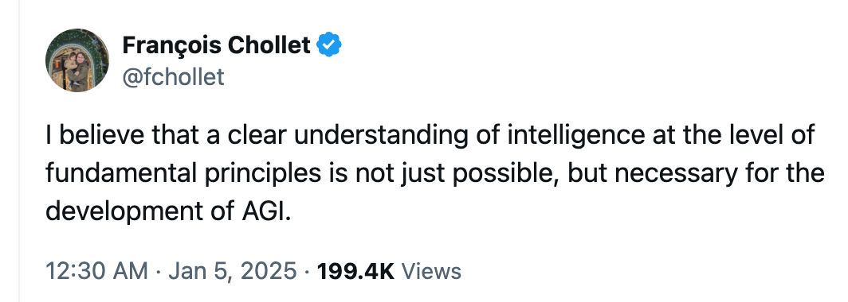
François Chollet, 5 Jan 2025 X
I believe that a clear understanding of intelligence at the level of fundamental principles is not just possible, but necessary for the development of AGI. Intelligence is not some ineffable mystery, nor will it spontaneously emerge if you pray awhile to a big enough datacenter.
Notes:
https://x.com/fchollet/status/1875701410165354518

Slide 73
Is this the same bitter lesson we don’t quite want to learn in education?

Slide 74
Is there a parallel to this in learning
Look up and know
1 9 1 9 1 9 2 0 1 9 2 1 1 9 2 2 1 9 2 3 1 9 2 4 1 9 2 5 1 9 2 6 1 9 2 7 1 9 2 8 1 9 2 9 1 9 3 0 1 9 3
Look and know
1919 1920 1921 1922 1923 1924 1925 1926 1927 1928 1929 1930 193
Notes:
How does this difference

Slide 75
Procedural vs conceptual knowledge
Conceptual | Procedural
Can be acquired by reading, lectures or discussion. | Can only be acquired through practice.
Definitions Comparisons History Literature Strategy | Mathematics Languages / Coding Surgery Sport Reading/writing
Notes:
There are many other kinds of knowledge and ways of dissecting knowledge.

Slide 76
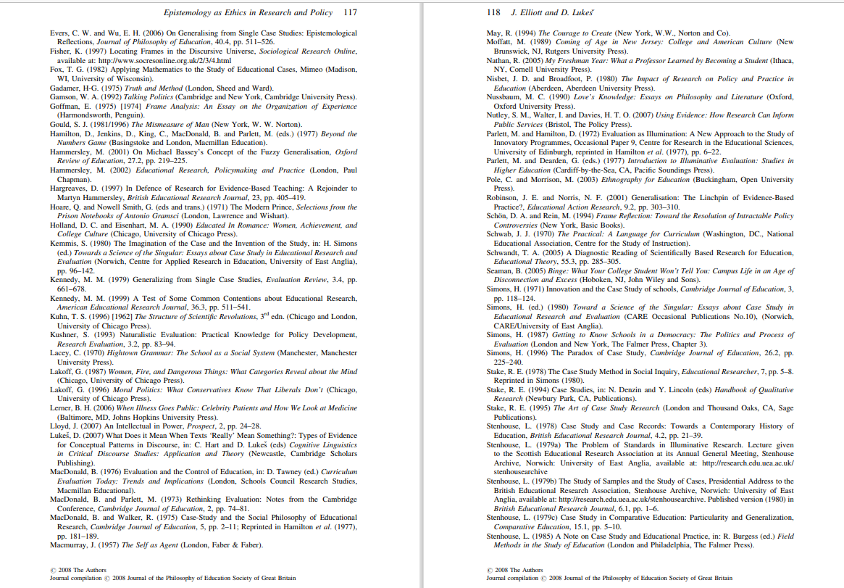
What is the difference between you and a student looking at the reference section

Slide 77
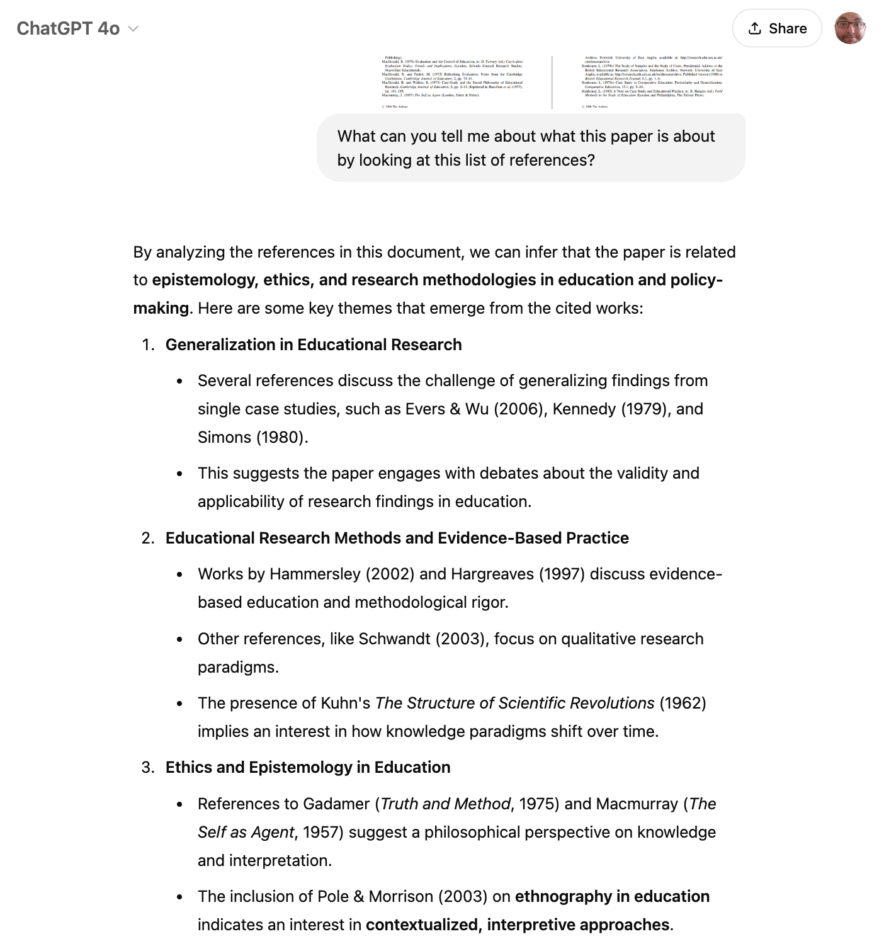
You see it, GPT-4o sees, but students don’t see it

Slide 78
The Socratic method

Slide 79
BF Skinner, The Technology of Teaching, 1968
[The Socratic Method] is one of the great frauds in the history of education.

Slide 80
Diana Laurillard, Rethinking University Teaching, 1993
The goal for Socrates is Truth, to be achieved through philosophical inquiry. That is not the same as a goal of enhancing the intellectual skills and understanding of others.

Slide 81
How can we move away from teaching the way we think we think to the way we learn?

Slide 82
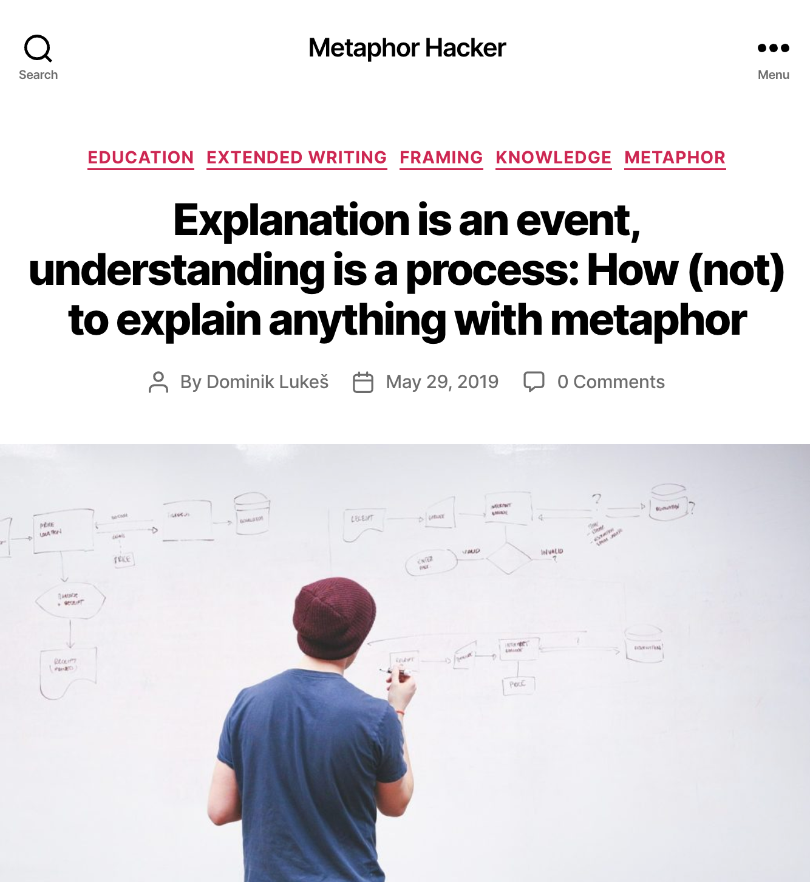
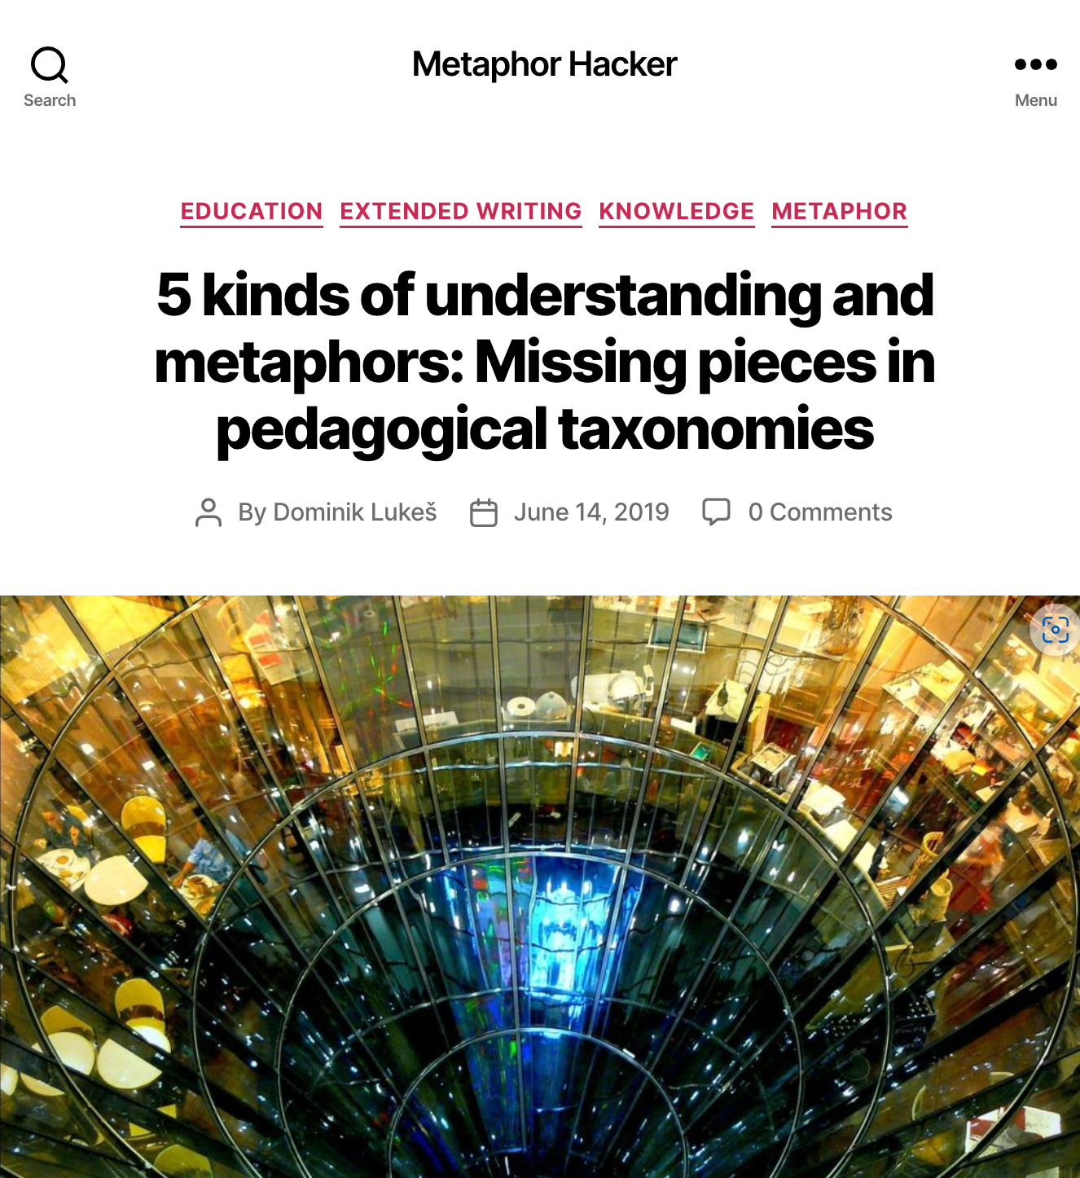
More on Metaphor and Knowledge on metaphorhacker.net

Slide 83
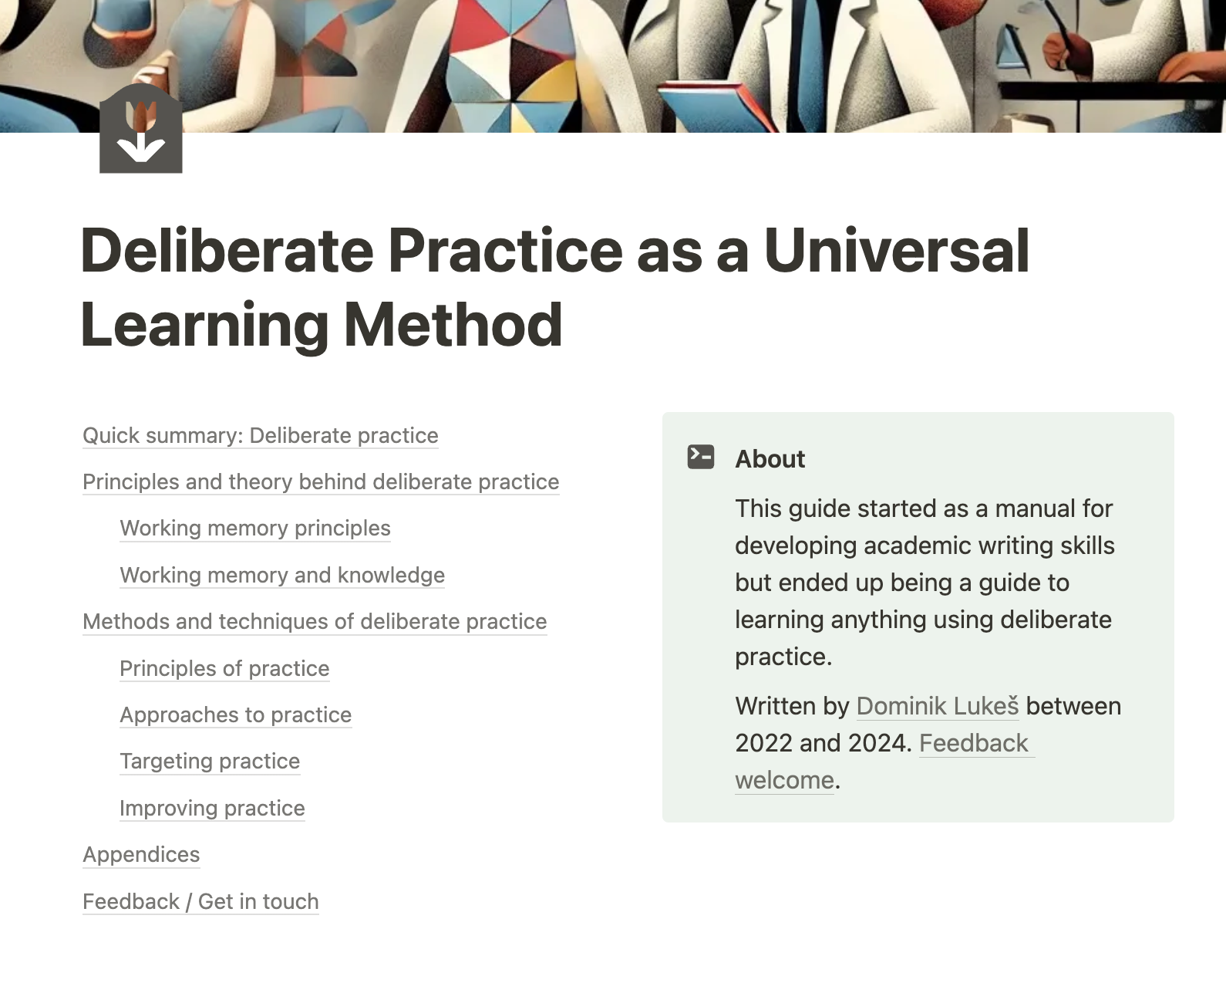
Deliberate Practice and Semantic Machines
deliberatepractice.notion.site
semanticmachines.notion.site

Slide 84
Thank you
Dominik.Lukes@oerc.ox.ac.uk

Slide 85
This presentation is licensed under Creative Commons By Attribution license except where otherwise noted. Icons and stock photos licensed under Microsoft Premium Content and cannot be reused outside this document.

